Slide 1
DAIKIN’s HOT GAS DEFROST
★ Principle
VAPOR
80℃
NON HEATED AIR
300 ～ 500 ℃
< HOT GAS >
< ELECTRIC HEATER >

Slide 2
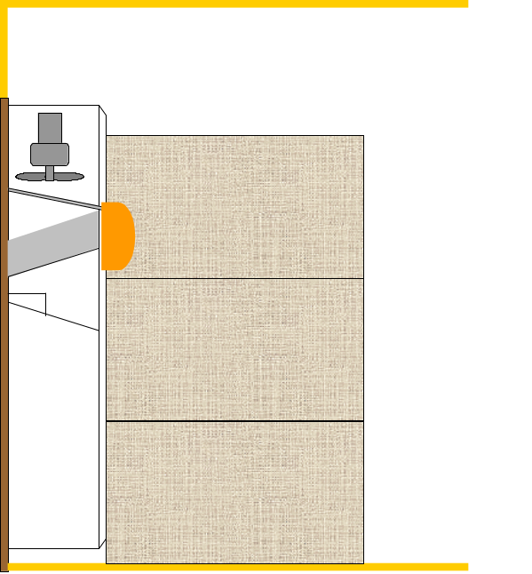
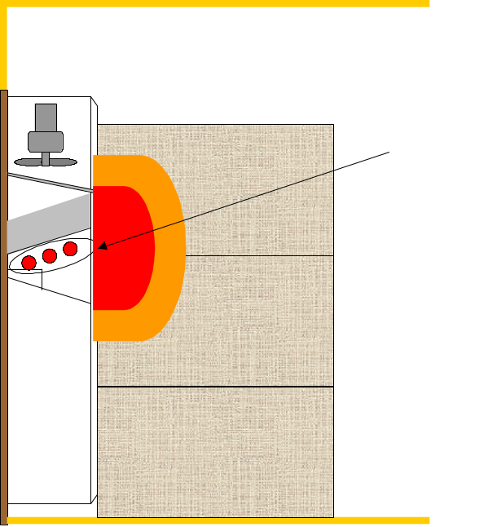
< HOT GAS >
< ELECTRIC HEATER >
Surface temperature
（Fin）
0～10℃ or lower
Wet Damage
Electric heater
Ice Cream Melts
Surface temperature
（Electric heater）
300～500℃
● Maintenance Free
● Megger check
● Replacement, every 4 years

Slide 3
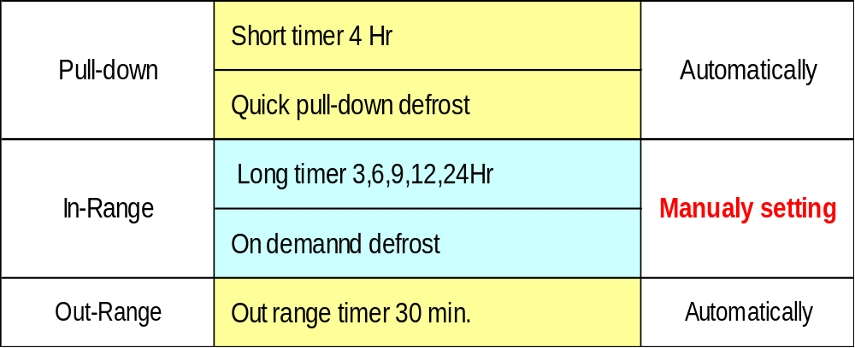
WHEN IS DEFROST OPERATION PERFORMED ?

Slide 4
ON DEMAND DEFROST
Defosting
Comp. ON
SP+1
SP
SP-1
Def. interval 12 hrs
12 hrs Re-count

Slide 5
QUICK PULL-DOWN DEFROST
≦0.2℃
4hr 4hr 4hr
1 hr
Shorter than 4 Hr
Short Timer 4 Hr

